Slide 1

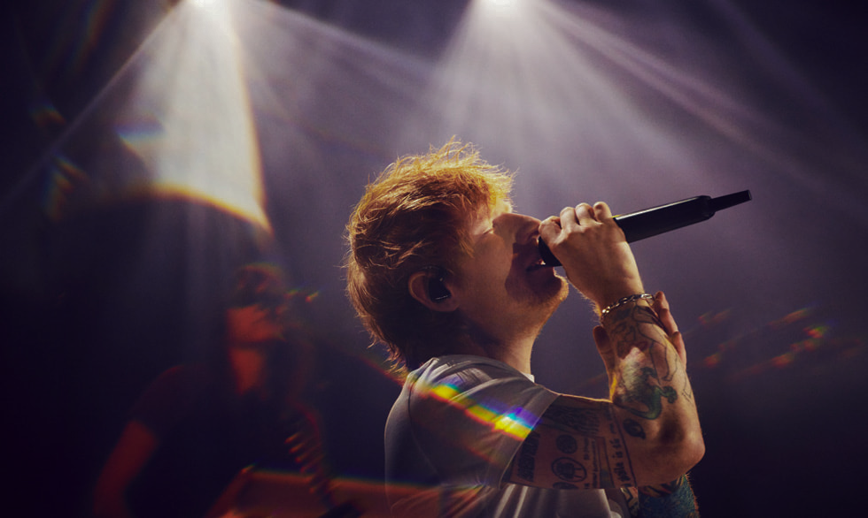




Ed Sheeran
2024 Integral
World Tour
Fan App
Buy Ticket Now
Venue
Around the world
APP Development Team:
Yifei Pan, Shuwen Chen, Wenxuan Wu, Wenqing Huang, Vivian Yin, Yuang Zhao, Yongting Chen
Date
15 JUN 2024 - 05 DEC 2024

Slide 2
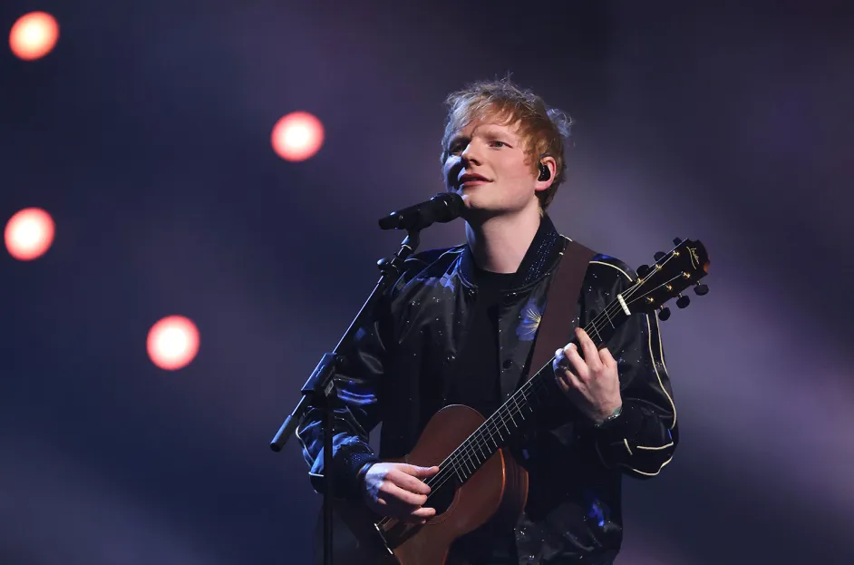




2024 Integral World Tour
Ed Sheeran
Grammy-winning singer-songwriter known for his heartfelt lyrics, soulful voice, and chart-topping hits that blend pop, folk, and acoustic music, making Ed Sheeran one of the most influential artists of his generation.
Albums
+ ("Plus") released in September 2011
× ("Multiply") released in June 2014
÷ ("Divide") released in March 2017
No.6 Collaborations Project released in July 2019
= ("Equals") released in October 2021
- ("Subtract") released in May 2023
Autumn Variation released in September 2023
Introduction
Data Sources
Database Design
Shiny App

Slide 3
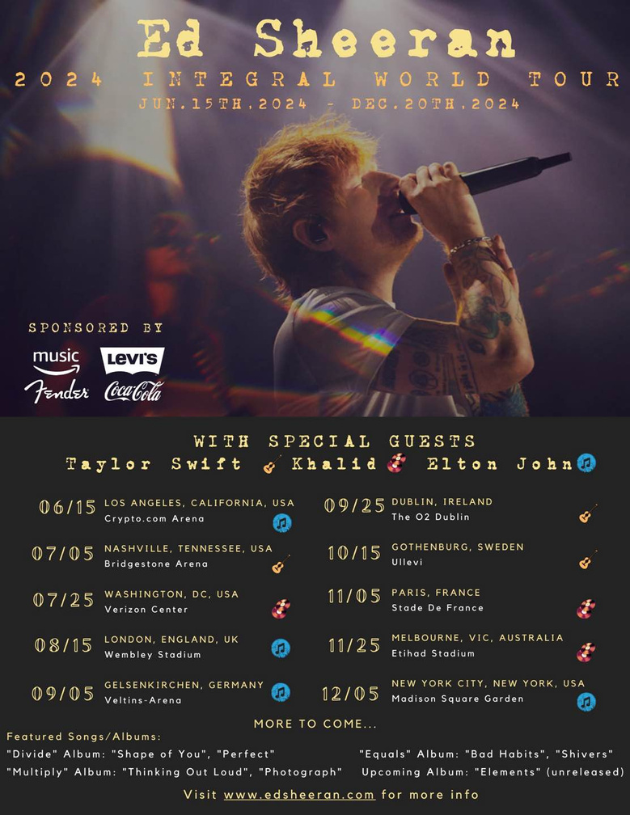
2024 Integral World Tour
"The Integral Tour" is a nod to Ed’s previous album, symbolizing how his music is an essential and unifying part of his fans' lives, just as integration is a fundamental concept in mathematics.
Date: 06/15/2024 - 12/20/2024
Venue: Ten world class venues across the globe
Special guests: Taylor Swift, Khalid, Elton John
Sponsored by : Amazon Music, Levi’s, Fender, Coca Cola
Introduction
Data Sources
Database Design
Shiny App

Slide 4

2024 Integral World Tour
An APP for Boosting Fan Engagement and Business Growth at Live Events.
App Capabilities and Business Impact:
Creates opportunities for monetization through partnerships with local businesses, hotels, and restaurants
Enhances fan experience by addressing logistical challenges at large-scale concerts
Offers personalized services like venue navigation and local recommendations
Provides new revenue streams for the event, hospitality, and entertainment sectors
Elevates fan engagement while driving sponsorship and business growth
Introduction
Data Sources
Database Design
Shiny App

Slide 5
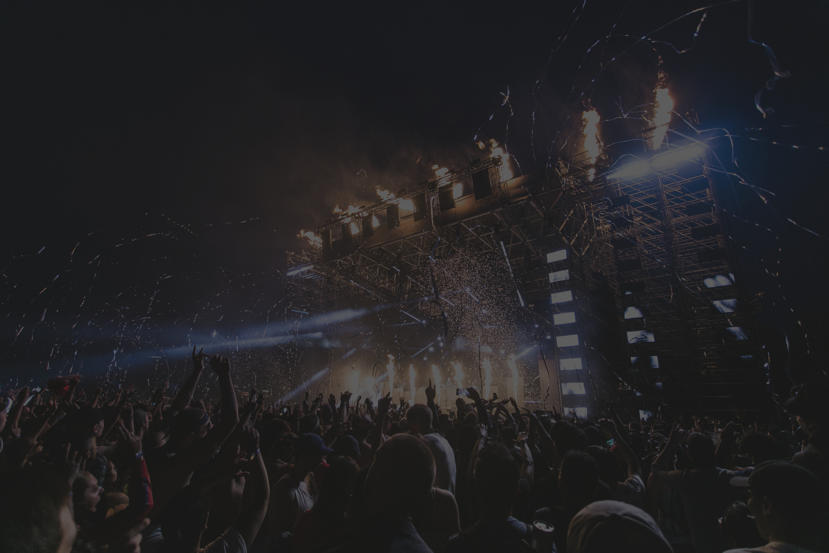



2024 Integral World Tour
CONTENT
Data Sources
Database Design
Shiny App
Introduction
Data Sources
Database Design
Shiny App

Slide 6



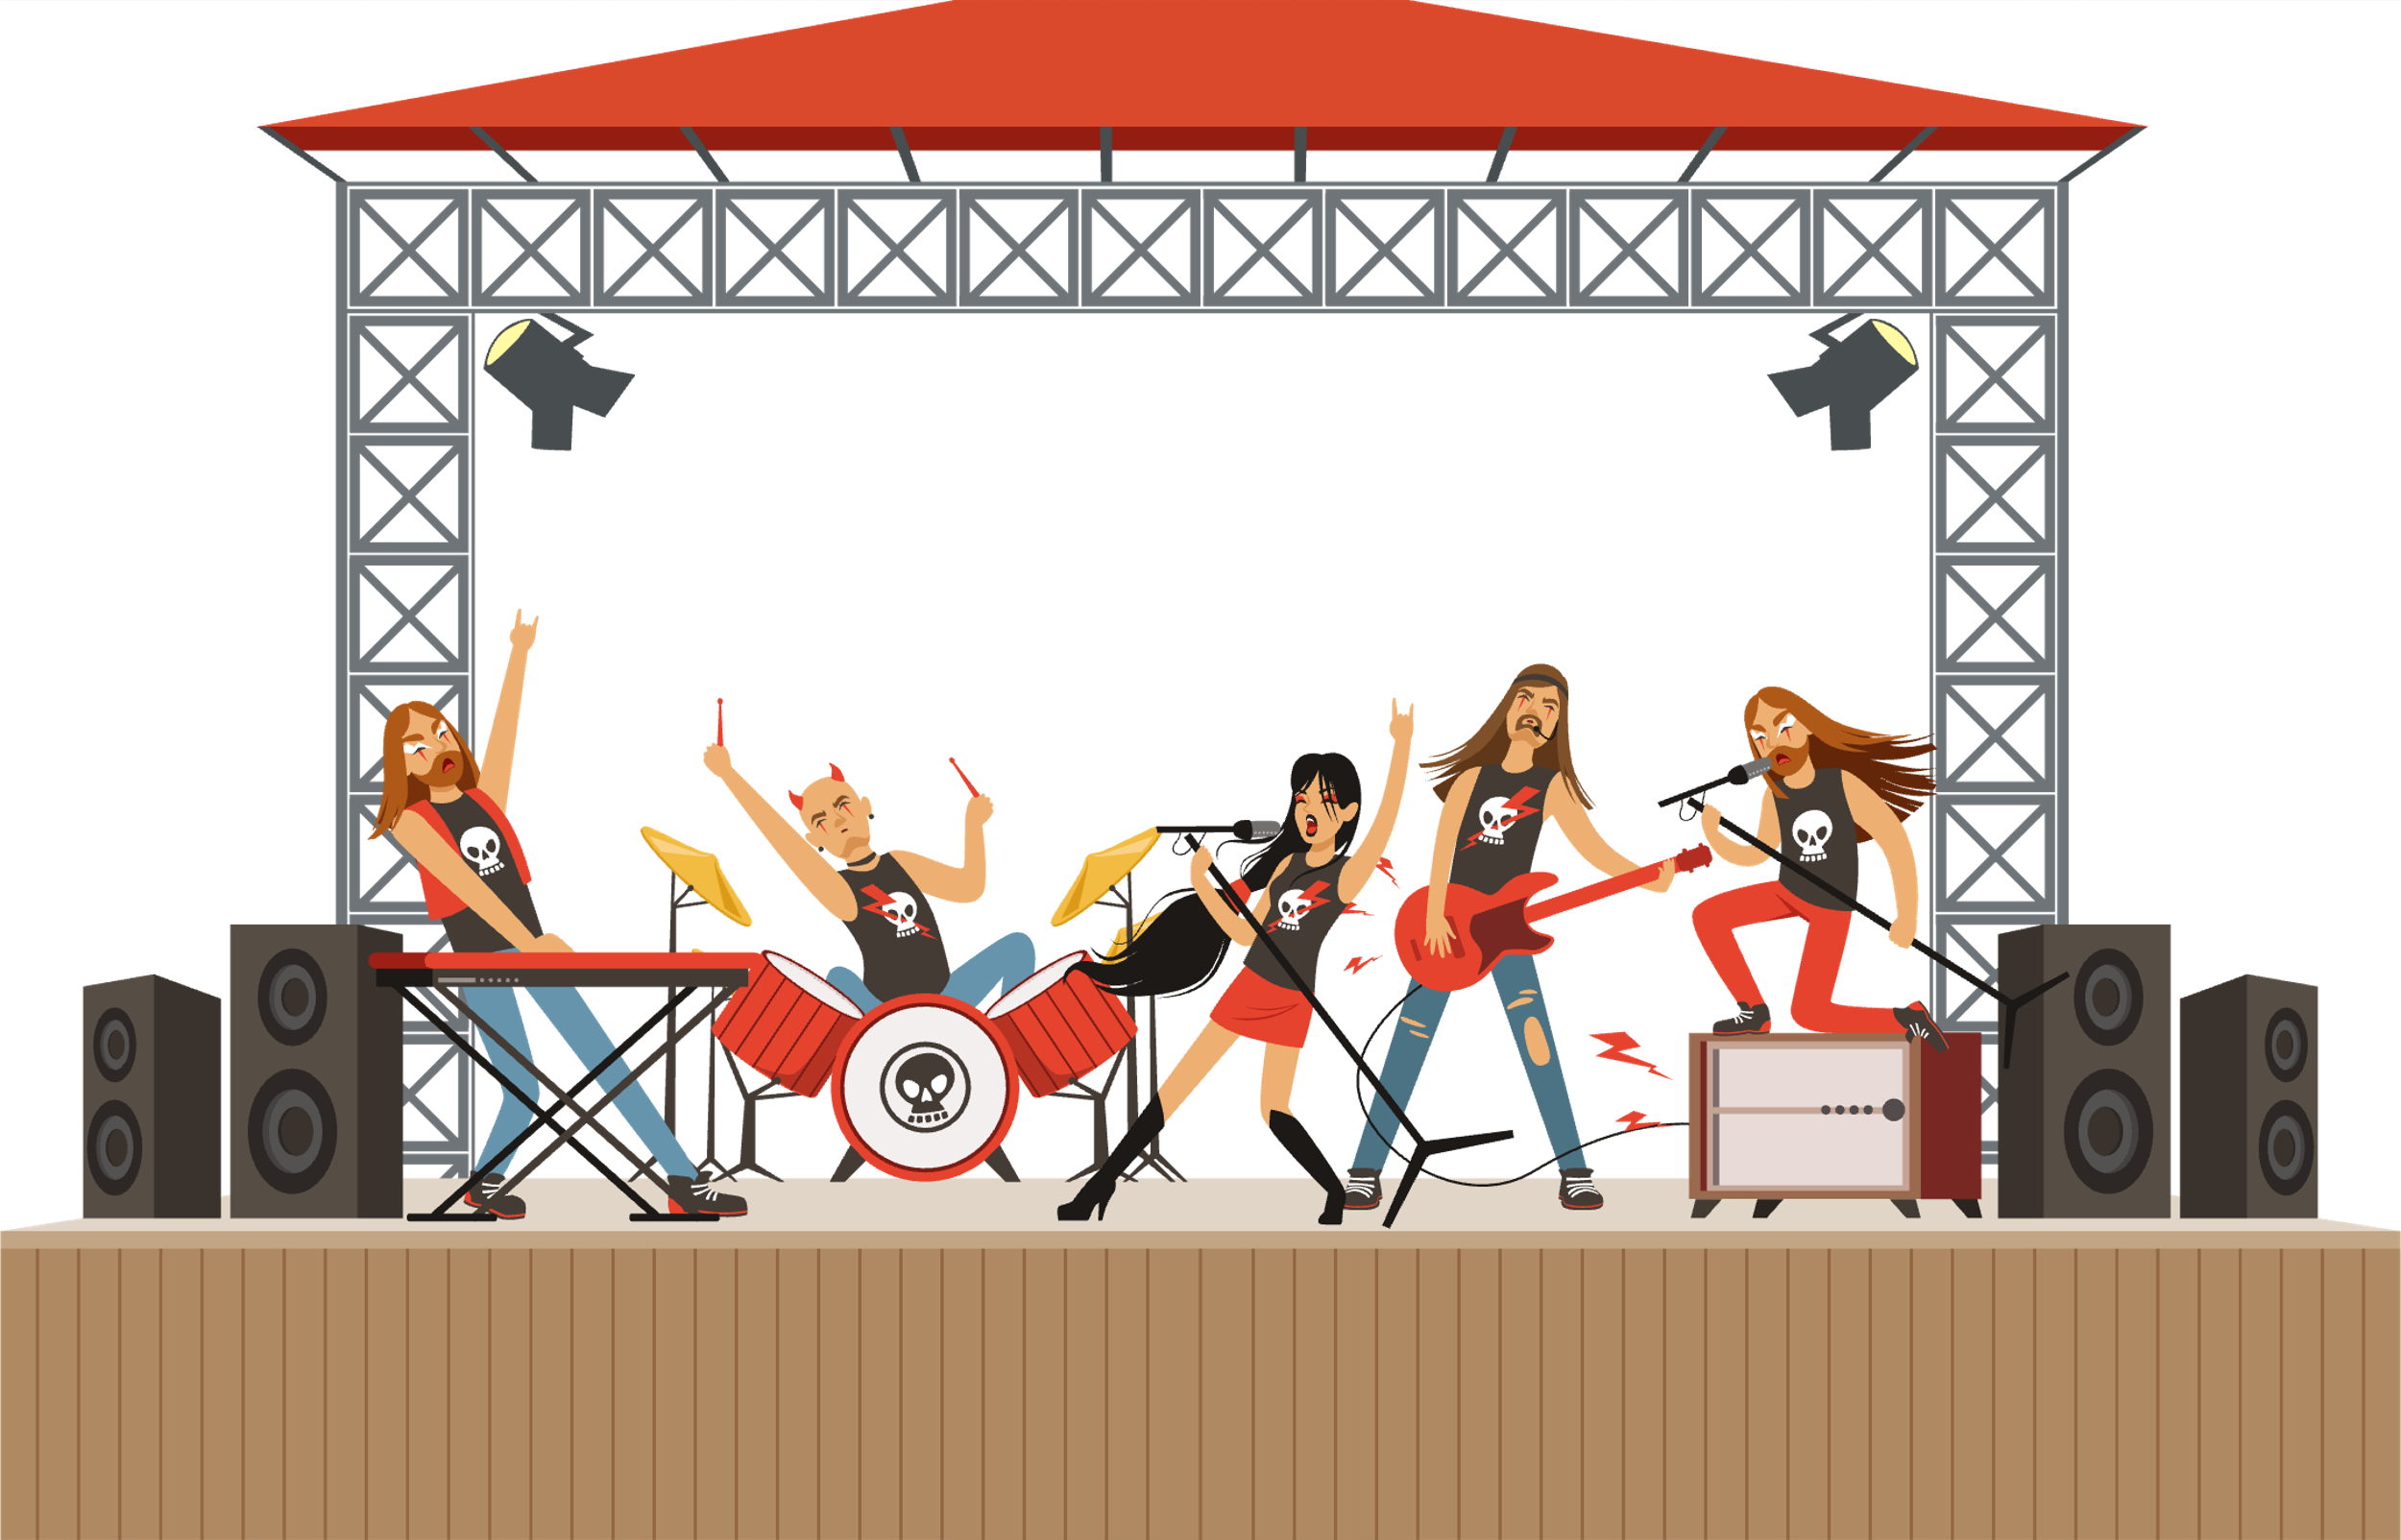

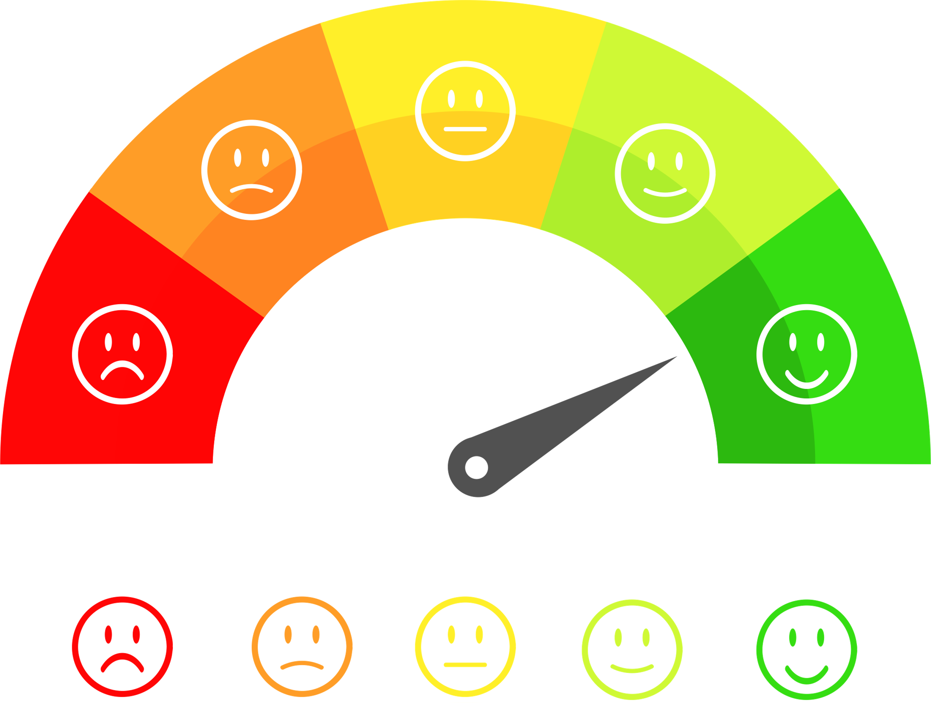





2024 Integral World Tour
Data Sources
Self-generated data
Venues
Restaurants
Emotions
Hotels
Videos
Songs&
Albums
Tickets
Entertainments
Introduction
Data Sources
Database Design
Shiny App

Slide 7
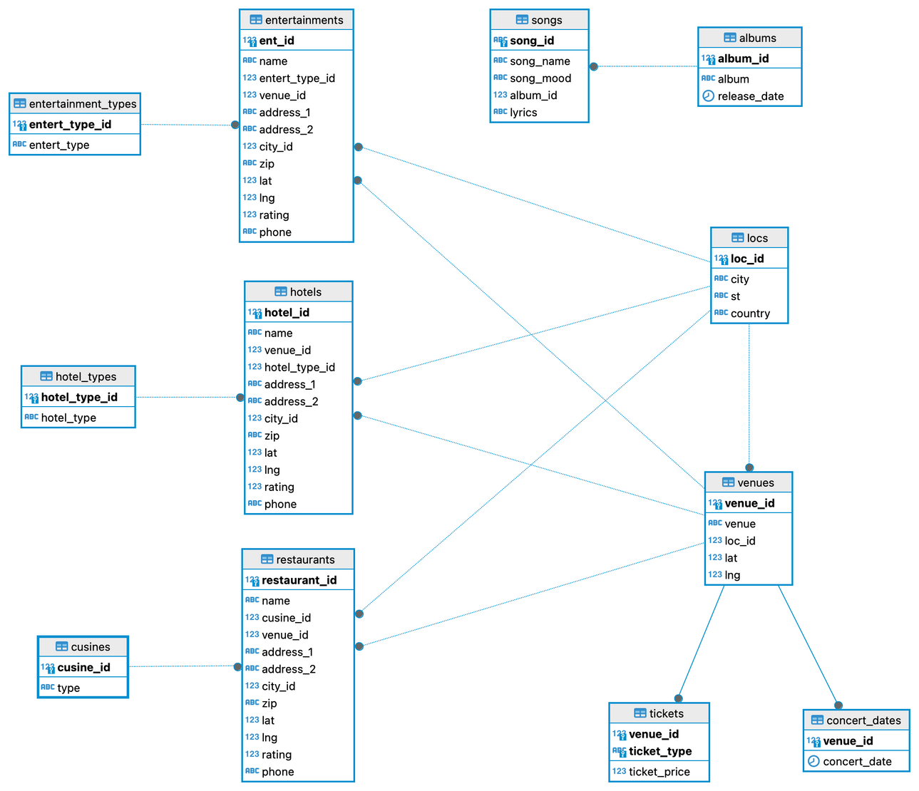
2024 Integral World Tour
Database Design
Clean
Normalization
ETL
Introduction
Data Sources
Database Design
Shiny App

Slide 8
2024 Integral World Tour
🔗Integral World Tour Fan App
Introduction
Data Sources
Database Design
Shiny App

Slide 9

2024 Integral World Tour
Thank You
For Watching

